Slide 1
Draft Financial Statement
July 2023
Fiscal Year 2024
Financial Report

Slide 2
OPERATING FINANCIAL STATEMENTS July 2023
Line of Credit balance as of August 17, 2023, is $3,262,485.02
Draft Financial Statement

Slide 3
OPERATING FINANCIAL STATEMENTS July 2023
Draft Financial Statement

Slide 4
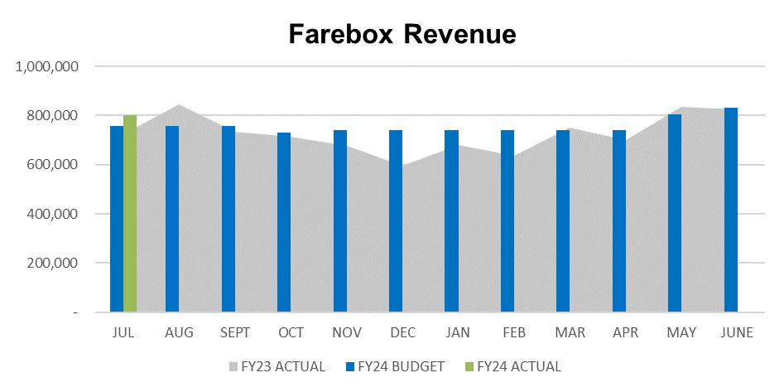
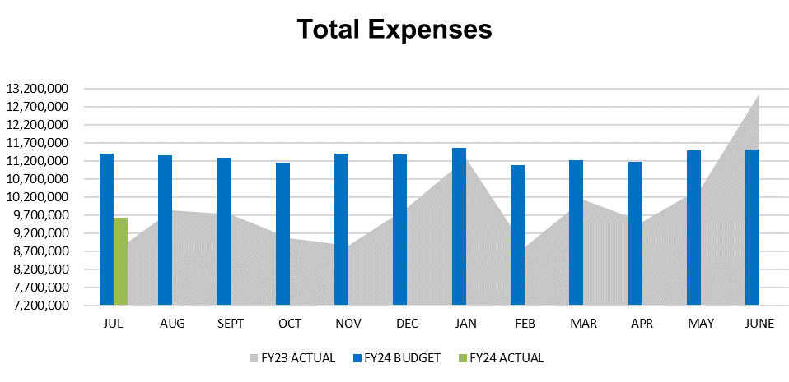
OPERATING FINANCIAL STATEMENTS July 2023
Draft Financial Statement

Slide 5
OPERATING CROSSWALK July 2023
Hampton Roads Regional Transit Funding for 757 Express and 15-minute increment.
Includes year-to-date estimated farebox surplus credit and/or service reliability credit, where applicable.
Draft Financial Statement

Slide 6
LOCALITY RECONCILIATION July 2023
Includes year-to-date estimated farebox surplus credit and/or service reliability credit, where applicable.
Draft Financial Statement

Slide 7
LOCALITY RECONCILIATION July 2023
Includes year-to-date estimated farebox surplus credit and/or service reliability credit, where applicable.
Draft Financial Statement

Slide 8
LOCALITY RECONCILIATION July 2023
Includes year-to-date estimated farebox surplus credit and/or service reliability credit, where applicable.
Draft Financial Statement

Slide 9
LOCALITY RECONCILIATION July 2023
Includes year-to-date estimated farebox surplus credit and/or service reliability credit, where applicable.
Draft Financial Statement

Slide 10
LOCALITY RECONCILIATION July 2023
Includes year-to-date estimated farebox surplus credit and/or service reliability credit, where applicable.
Draft Financial Statement

Slide 11
LOCALITY RECONCILIATION July 2023
Includes year-to-date estimated farebox surplus credit and/or service reliability credit, where applicable.
Draft Financial Statement

Slide 12
LOCALITY RECONCILIATION July 2023
Includes year-to-date estimated farebox surplus credit and/or service reliability credit, where applicable.
Draft Financial Statement

